Slide 1




Technology Trends &
Analysis
Deepak Vaswani
14 July, 2022

Slide 2

OUTLINE
Executive Summary
Introduction
Methodology
Results
Visualization – Charts
Dashboard
Discussion
Findings & Implications
Conclusion
Appendix

Slide 3

EXECUTIVE SUMMARY
Trends in programming languages and databases
Demographics survey
Technological gap in countries
Gender gap in jobs

Slide 4

INTRODUCTION
About:
Analyzing the trends in software development
Purpose:
Identify skill requirements for future
What are the top programming languages in demand?
What are the top database skills in demand?
What are the popular IDEs
Audience: Human Resource and IT Head

Slide 5

METHODOLOGY
Data Collection Sources
Stack Overflow Developer 2019 Survey
GitHub Job Postings
Programming Languages Annual Salary
Data Exploration
Data Cleaning
Data Visualization
Presentation

Slide 6
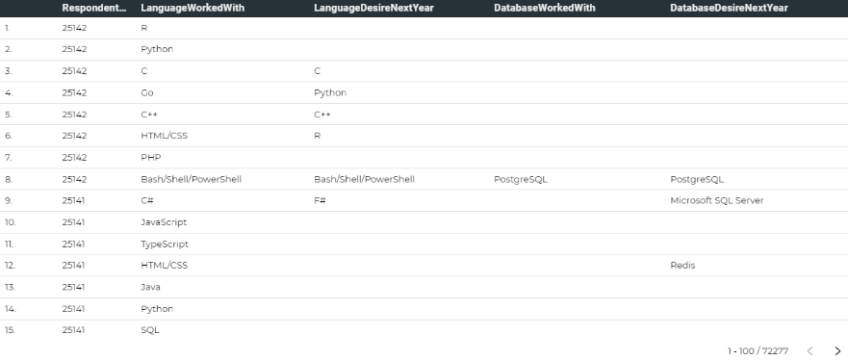
RESULTS

Slide 7
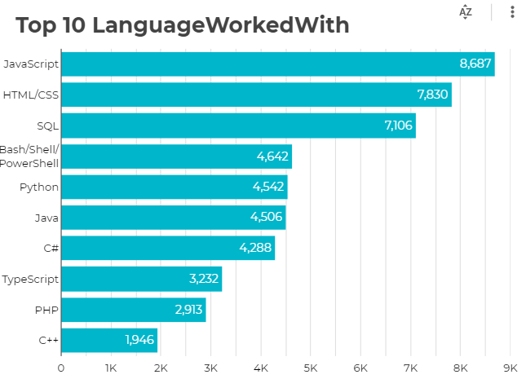
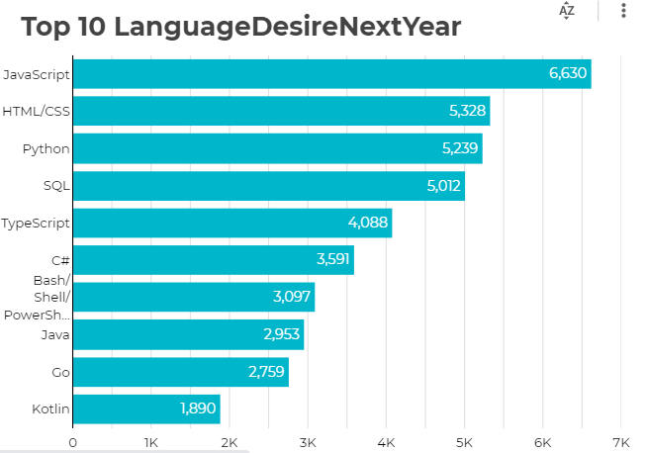
PROGRAMMING LANGUAGE TRENDS

Slide 8
PROGRAMMING LANGUAGE TRENDS - FINDINGS & IMPLICATIONS
Findings Implications
JavaScript, HTML/CSS, SQL are top 3 this year
Python and Typescript becoming popular next year
PowerShell edged out in next year
Web development are still in high demand
Big Data technology in companies still requires SQL
With AI and ML in rising demand, Python is best choice

Slide 9
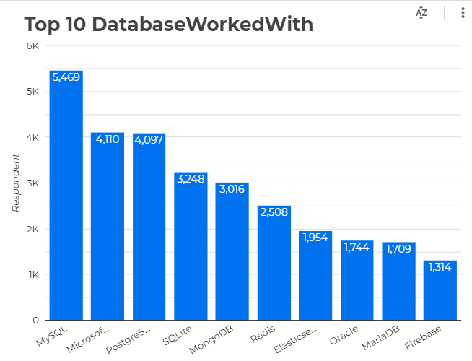
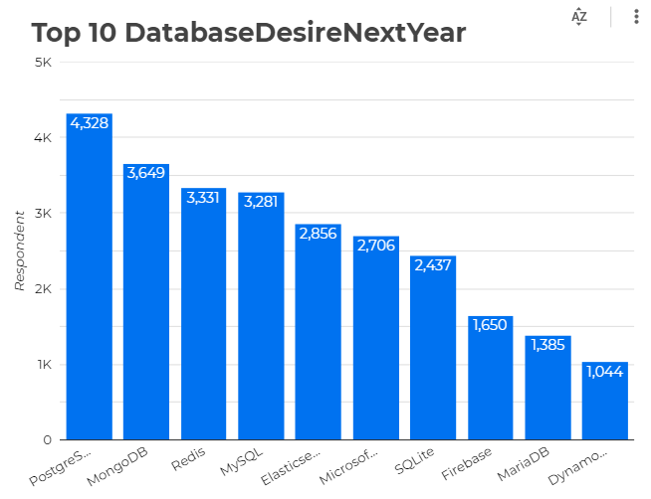
DATABASE TRENDS

Slide 10
DATABASE TRENDS - FINDINGS & IMPLICATIONS
Findings Implications
MySQL most popular
Behind is Microsoft SQL
MongoDB and Redis are upcoming favorites
New kid on the block: Elasticsearch
Open source databases are still preferable in companies
NoSQL databases will make an impact for storing non relational data
Redis supports abstract data types
Pre tuned search to website, app, or ecommerce store

Slide 11

DASHBOARD
https://dataplatform.cloud.ibm.com/dashboards/1cdfc30c-0a07-4478-881f-76c642772888/view/6f12ab1800a871e251f2d4e407ca295575317054e4bb815780817b490c627897f0694199c87c185c8c445161f7e8410a98

Slide 12
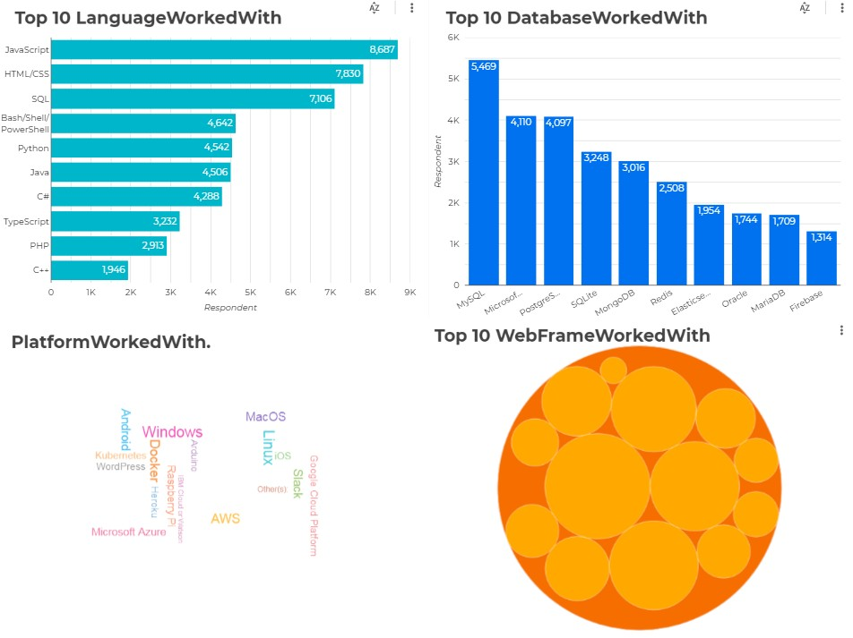
DASHBOARD TAB 1

Slide 13
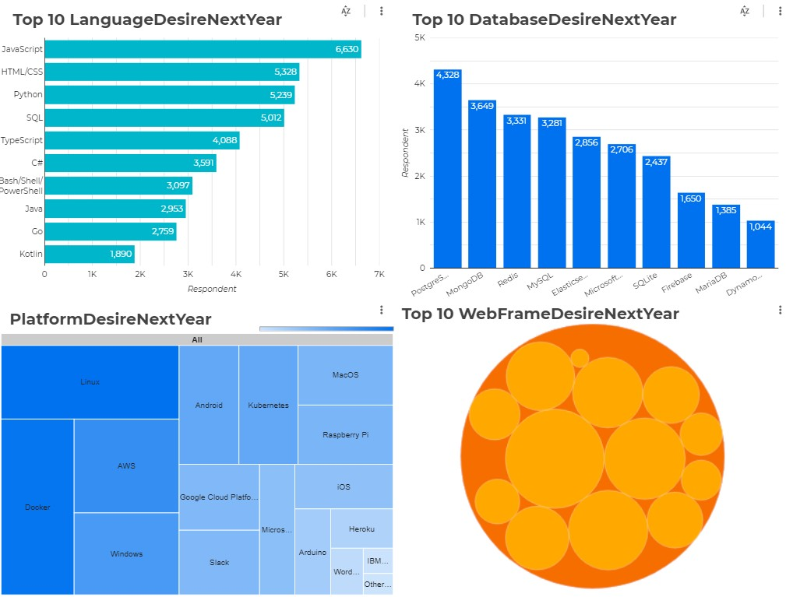
DASHBOARD TAB 2

Slide 14
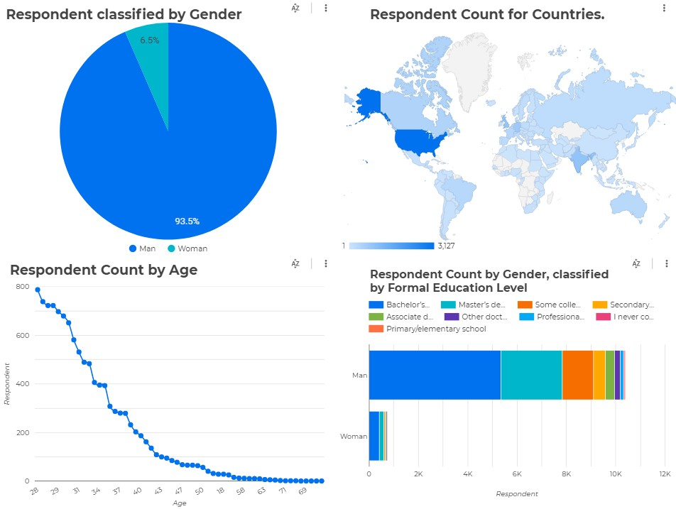
DASHBOARD TAB 3

Slide 15
DISCUSSION
Technology Trends now and future
Training and Reskilling workers
Females participation in Technology field
Bridge divide of technology gaps in developing countries
Eliminate age and education discrimination in employment

Slide 16
OVERALL FINDINGS & IMPLICATIONS
Findings Implications
Fast changing technology every year
Concentration on several countries like USA and India
Gender gap in technology jobs
Platforms like Docker and AWS are growing
Companies need to be flexible and adjust to rapid changes
Need to spread technology out to lagging countries
Impact of job hiring’s
Shift to faster app deployments and cloud services in future

Slide 17

CONCLUSION
Technology Trends for current and next year
Programming Languages, Database and Platform overview
Demographics overview
Actions to be taken
In future, incorporate Machine Learning to predict trends and salaries

Slide 18
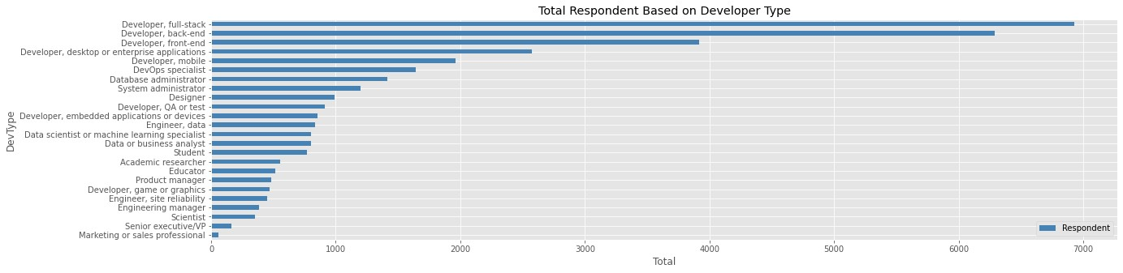

APPENDIX

Slide 19
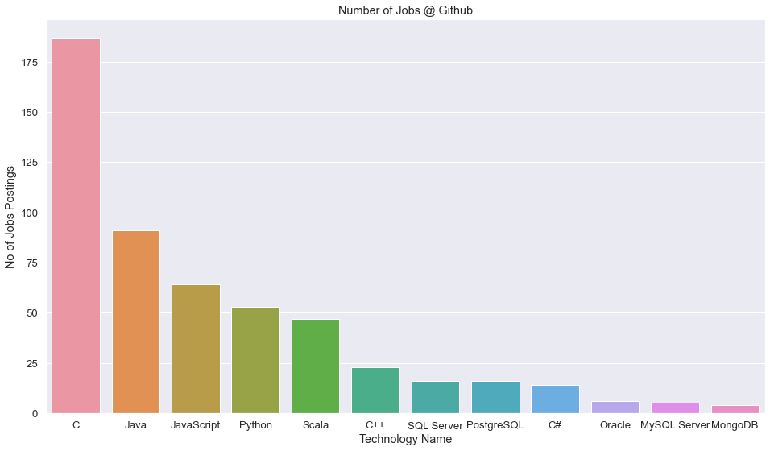
GITHUB JOB POSTINGS

Slide 20
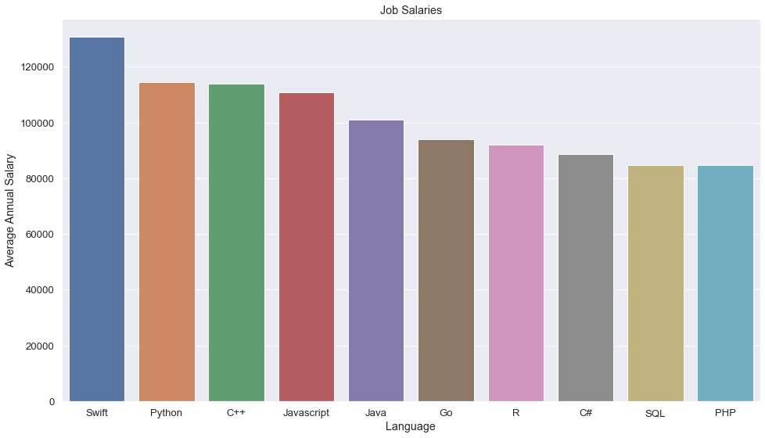
POPULAR LANGUAGES

